Slide 1
Dynamic Program Analysis for DataSnap Problems

Slide 2
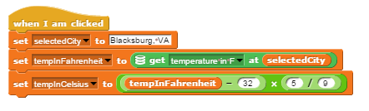
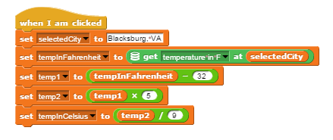
Dynamic Program Analysis
The teacher will drag and drop blocks to form a "teacher program" and the student will drag and drop blocks to form the "student program".
Run the teacher instance of the problem against the student instance of the problem with the same inputs, and compare to make sure the same outputs are received.
Student program
Teacher program

Slide 3
Convert Fahrenheit to Celsius
Example: Convert Fahrenheit to Celsius
Teacher codes a sample solution in DataSnap.
Break down the problem: f is a function of an input x, generating a solution y. Denoted: y = f(x)
Therefore, the teacher defines:
x: program inputs.
f: program algorithm
Y: program outputs.

Slide 4
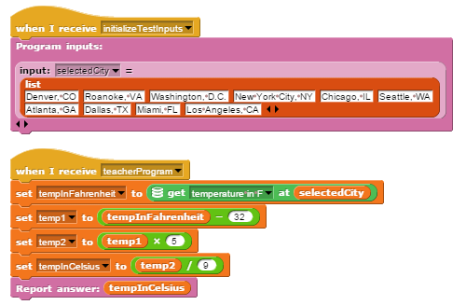
Convert Fahrenheit to Celsius
Teacher program
1) x: program inputs
In this scenario, the teacher will provide the names of 10 cities, which will serve as the test inputs for grading.
Thus the problem is divided into two parts:
1) Initilalize inputs
2) Teacher Program
2) f: program algorithm
1
2
Notes:
Notice the changes
--From “When I am clicked” -> When I receive “initializeTestInputs”, and “teacherProgram”.
--The “set selectedCity to Blacksburg, VA” block has been removed. We want support for 10 inputs, for example, not just one input.

Slide 5
Convert Fahrenheit to Celsius
3) y: program outputs
The student and teacher need some way of reporting their answer.
Finished Teacher program:

Slide 6
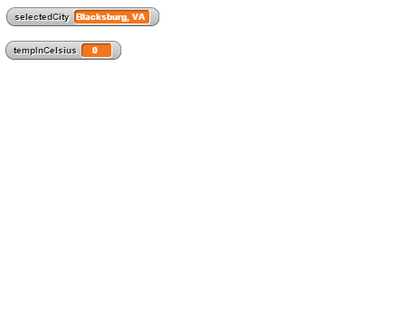

Convert Fahrenheit to Celsius
The teacher develops a student problem skeleton:
1) Define ONE sample input:
selectedCity = Blacksburg, VA
2) Let the student develop their algorithm:
(More info on next few slides)
3) Define the output:
Report answer: tempInCelsius
Stage Area:
Scripts Area:

Slide 7
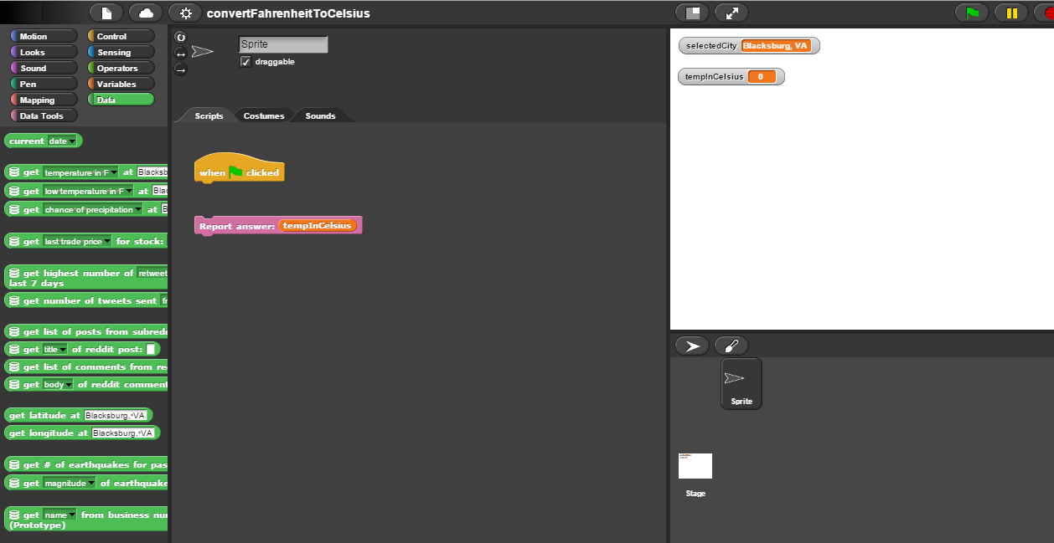
Convert Fahrenheit to Celsius
The teacher develops a student problem skeleton:
2) Let the student develop their algorithm:
2A) (Optional) Customize the DataSnap environment to generate a more focused experience for the student.
Hide unneeded block categories
Hide unneeded blocks
Save this information in a JSON configuration file.

Slide 8
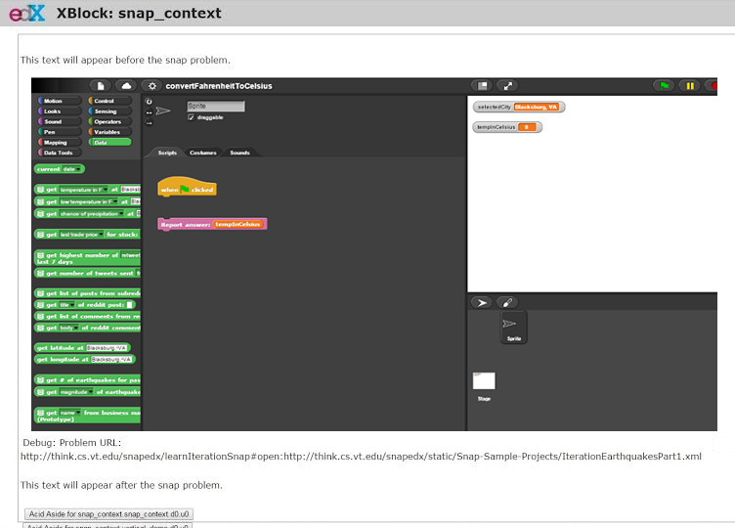
Convert Fahrenheit to Celsius
The teacher develops a student problem skeleton:
2) Let the student develop their algorithm:
2B) Develop question pre-text and post-text.
Save this information in a JSON configuration file.

Slide 9
Project Architecture and Implementation

Slide 10
Data Storage
What needs to be stored:
Before Runtime:
teacherProgram.xml
studentSkeleton.xml
problemConfiguration.json
During Runtime:
studentProgram.xml
Student program information:
Array of outputs: 10 tempInCelsius outputs from the student program
(Optional) State of other variables for each invocation:
tempInFahrenheit, intermediate variables, etc.

Slide 11
Architecture
Show a diagram of our architecture and how this actually works.

Slide 12
Reference Implementation Details

Slide 13
Notes:
When a teacher is developing the solution to their problem:
When the teacher creates variables, the variables must be “For this sprite only” (object variables) , not “For all sprites” (global variables).
Why? = These variables need to be separate from the student variables. We wouldn’t want to overwrite a student variable.
Future Work: refactoring can automatically convert “global variables” to “object variables” for teachers who forget to do this.

